Slide 1
EDELMAN
Project Clairvoyant – Initial Plan
EDELMAN DXI / © 2020

Slide 2





POC WILL BE BASED ON A SINGLE BRAND (FROM PREVIOUS EDM RESEARCH)
Brand A
Pull all articles for Brand A
Longer Term: A drop down tool to select any Edelman Trust Brand
Entity

Slide 3
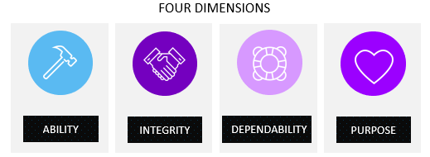
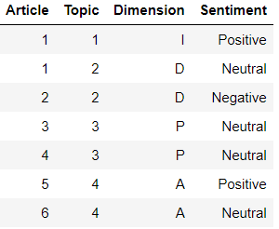
ASSIGN A TRUST DIMENSION TO EACH ARTICLE & CALCULATE SENTIMENT AT AN ARTICLE LEVEL
300+ Signal Topics
15 EDM Topics
Trust Dimension
(A, I, D, P)
Brand A
Article 1
Pull all articles for Brand A
Topic 1
Topic 2
Article 2
Longer Term: A drop down tool to select any Edelman Trust Brand
Topic 2
Article 3
Topic 3
Overall Sentiment Score for each Article – Based on Brand Entity Only
Entity
Articles

Slide 4
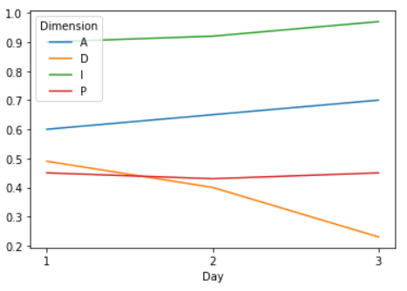

EACH TRUST DIMENSION WILL BE ASSIGNED A FINAL TRUST SCORE & WILL BE TRACKED OVERTIME
Combine into composite ‘Trust’ Score
Brand A – Trust Overview
Ability
Positive
0.70
Integrity
Positive
0.97
Dependability
Negative
0.23
Purpose
Neutral
0.45
300+ Signal Topics
15 EDM Topics
Trust Dimension
(A, I, D, P)
Score based on # of +ve, -ve, neutral article hits?
Brand A
2 new articles about Brand A, Topic 4. Keywords: Entity 1, Entity 2…
Links to articles.
Article 1
Pull all articles for Brand A
Topic 1
Topic 2
Article 2
Longer Term: A drop down tool to select any Edelman Trust Brand
Topic 2
Article 3
Topic 3
Overall Brand Stats
A
Score 0.70 vs. average X Competitor Score
Best topic areas vs. areas for concern
Overall Sentiment Score for each Article – Based on Brand Entity Only
I
Score 0.97 vs. average X Competitor Score .....
Entity
Articles
Score
Notes:
Can they provide a score for sentiment – this way we can combine scores rather than counting positive/negative

Slide 5
TRUST SCORE COMPONENTS
The following metrics will make up the components of the composite Trust Score:
If a Brand is mentioned more times in an Article, that Article should have a larger effect on trust
SALIENCY RANK
Positive, Neutral, Negative sentiment labels denoted 1, 0, -1
SENTIMENT
Recent articles will have more of an effect on trust than older articles
RECENCY
Popular Article = larger audience = more effect on overall trust. (Use # of articles per story or Page Rank)
STORY POPULARITY

Slide 6
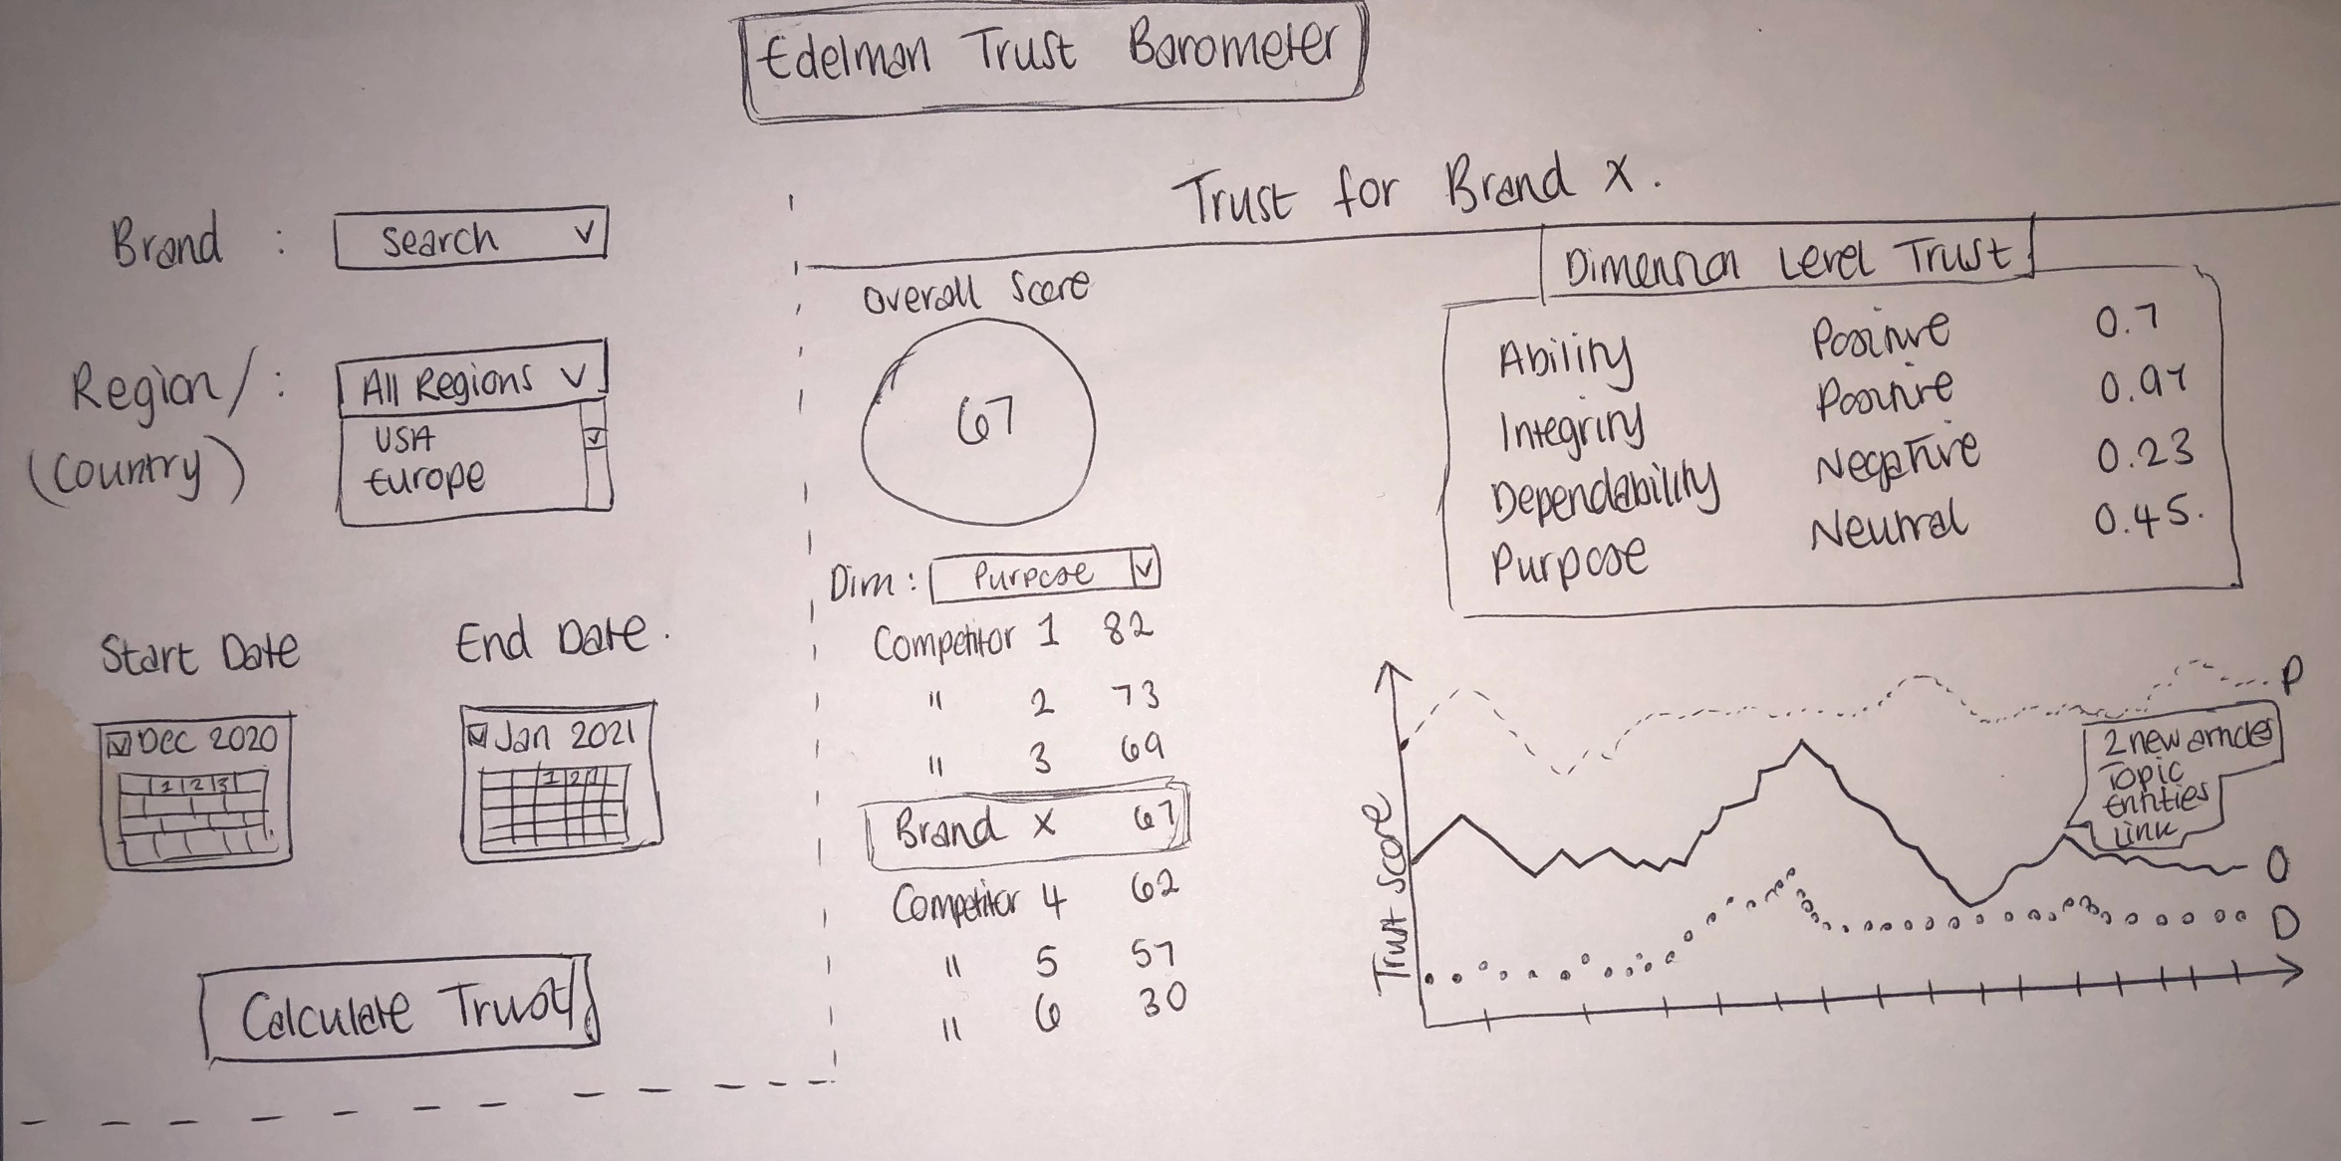
INITIAL WIREFRAME IDEAS

Slide 7
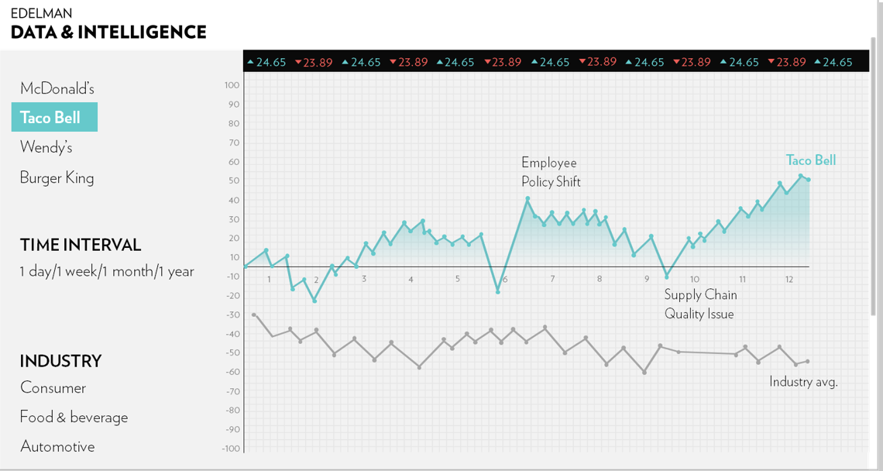
INITIAL WIREFRAME IDEAS

Slide 8
APPENDIX
EDELMAN DXI / © 2021

Slide 9
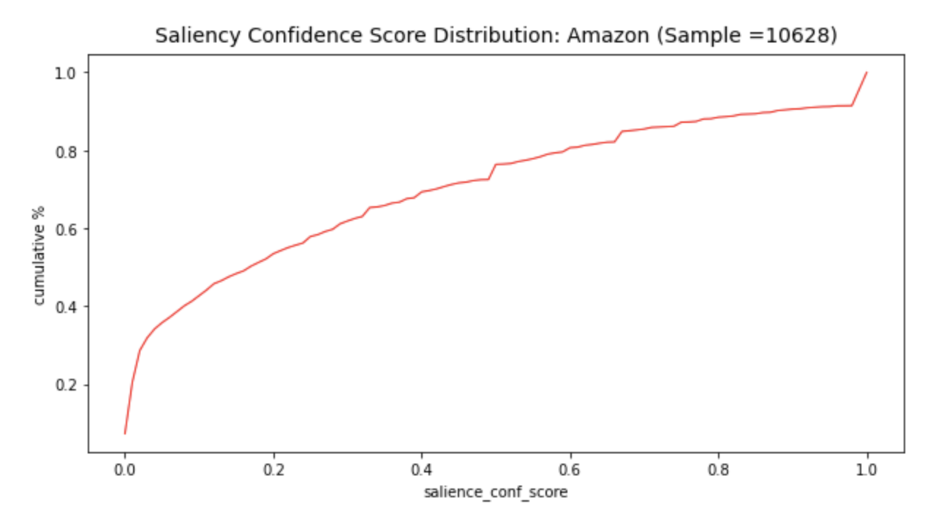
Saliency distributions (Amazon)

Slide 10
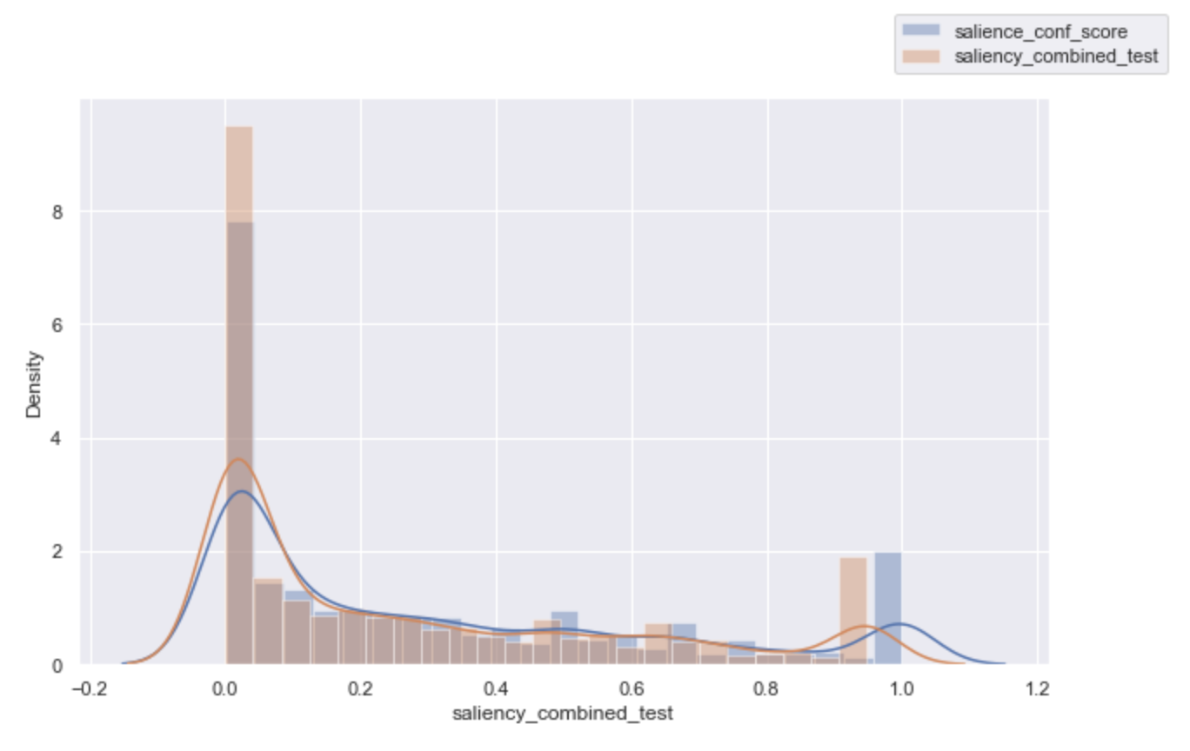
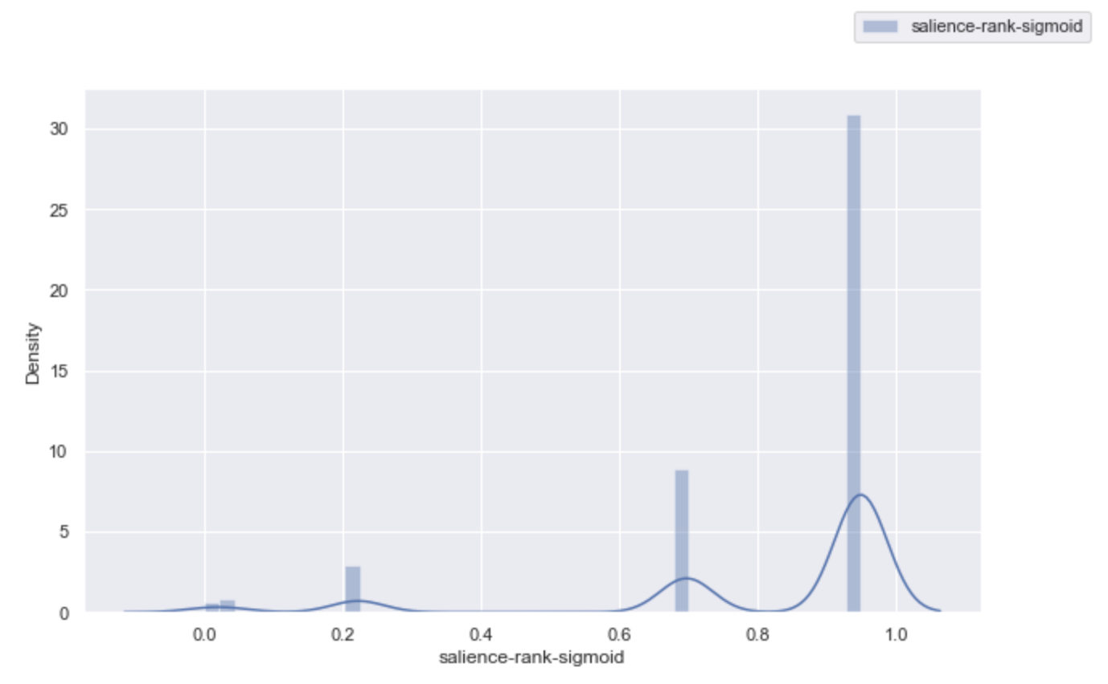
Saliency distributions (Amazon)

Slide 11
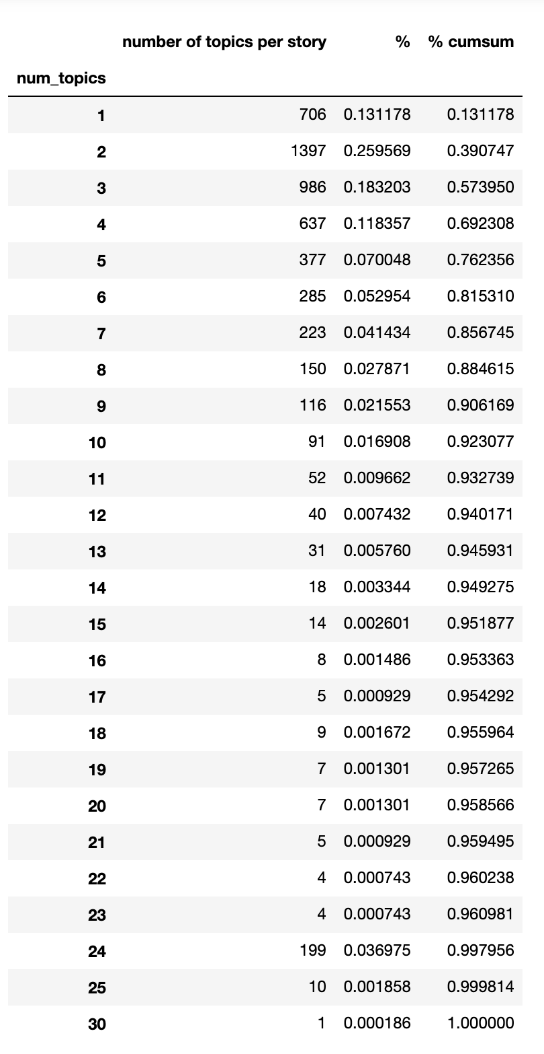
Amazon: Number of Topics per article

Slide 12
QUESTIONS FOR SIGNAL
Access to raw text from the API. As mentioned today, even if this is access to the sentences that contain each entity, this would allow us to run our own language algorithms on the text
This would allow us to align our approach across multiple text sources (Discussion/survey data for example)
We have a desire to develop language based models that give us a "truer" measure of trust (Amongst other key text based measures within our business).
It's our understanding that deploying new language algorithms on your serverside (to circumvent the licencing issues) is not possible - please correct us if we are wrong.
If there are key providers we can work with to licence this data, please outline this so we can consider that as an option
Access to Sentiment scores, not just flags.
As mentioned sentiment scores/maginitude can vary drastically. Two articles, both with negative sentiment entities, can differ drastically in terms of the severity. We need to be able to differentiate.
Also when creating the final Trust scores, we should include as much information as possible, right now we are counting flags, which is analogous to summing averages, when we have the raw data, losing valuable information.
Is it possible to gain access to these scores, if so, what are the expected timelines of this?
Access to Saliency scores:
Same reason as sentiment
Access to topic classification likelihood scores:
Similar reasons to the above but having the scores, and different combinations of scores, allows us to make decisions about how we prioritise articles.
As mentioned, although we have ranking in the API we have our hand's tied slightly and what we see in the response is missing information that allows us to make more informed decisions about what is and is not relevant
Differences in classification likelihood of 2 topics can also vary. Sometimes we may need to be more stringent on these measures and increase the classification cutoff. A likelihood of 0.6 vs 0.99 should be used, rather than comparing True and True per the existing results.
Is it possible to gain access to these scores for each topic?
Training our own Entities
As mentioned we want to be able to calculate trust scores for any brand. Currently there are Y number of brands available in the API but what are the steps required to train our own, new, entities?
How can we improve the classification for key brands with the API? As previously mentioned a quick test of Amazon found around 100 articles in a single month that were both labelled as Amazon.com and AmazonRainforest (Both with Saliency=True).
Identifying the right articles for the right Brand is super important to us, especially if we are providing this client side. Our credibility of misclassifying articles for their brand would take a serious hit.
Is there a way we can retrain this? (I think you mentioned the offshore team in India), what are the steps involved from our/your end?
Training our own Topics:
What are the steps to doing this?
How often can we train our own topics?
Exactly what do we need? A seed of X number of articles per topic

Slide 13
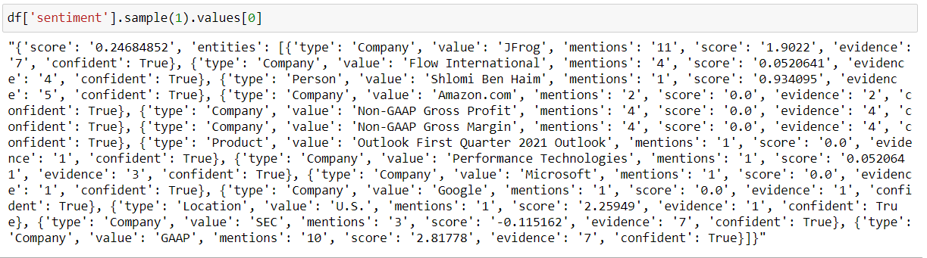
LN Sentiment Output
Article Sentiment
Brand Sentiment
Saliency:
# Brand Mentions / # Company Mentions

Slide 14
Front End
Html, CSS, Reactjs
WebServer
Python, Flask
Data
Warehouse
MySQL, Postgress, Snowflake
Trigger
2nd Job
Data Pipeline 1
Update Raw Data

Slide 15
Data Pipeline 2
def fetch_data(last_id):
SELECT … FROM Table
def processed_data():
data ETL
compute_trust_elements
index_term mapping
def calc_trust(w0, compute_date):
compute_recency_from_now
compute_trust_score
WEB SERVER API
def fetch_data(last_id):
SELECT … FROM Table
Front End
Html, CSS, Reactjs
def upload_data():
UPDATE … TABLE
Data
Warehouse
MySQL, Postgress, Snowflake
def data_ETL():
resample
grouping
simple aggregation
Trigger
2nd Job
Data Pipeline 1

Slide 16

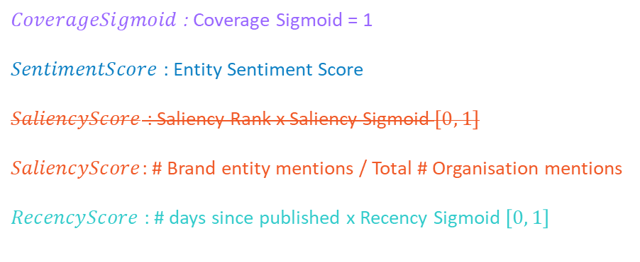

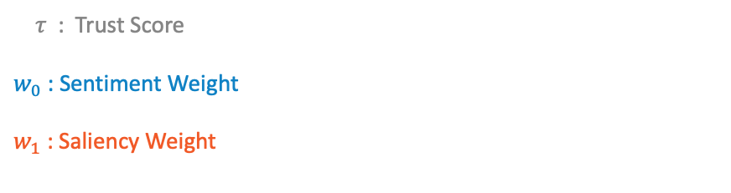
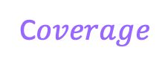
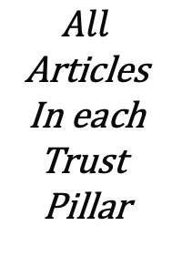
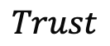

TRUST SCORE CALCULATION (PER TRUST DIMENSION)
$$τ = \sum_{Total Stories}{ \left(CovSigmoid\left(Total \# URLs\right)\sum_{n=1}^{Total \# URLs}{\frac{ w_{0}SentiScore × w_{1}SaliencyScore × RecScore}{Total \# URLs}}\right)}$$
$$Trust$$
$$All$$
Articles
In each
Trust
Pillar
C$overage$
$$Tonality$$
$$Relevency$$
$$Recency$$
$τ$ : Trust Score
$w_{0}$ : Sentiment Weight
$w_{1}$ : Saliency Weight
$CoverageSigmoid$ : Coverage Sigmoid = 1
$SentimentScore$ : Entity Sentiment Score
$SaliencyScore$ : Saliency Rank x Saliency Sigmoid $\left[0, 1\right]$
$SaliencyScore$: # Brand entity mentions / Total # Organisation mentions
$RecencyScore$ : # days since published x Recency Sigmoid $\left[0, 1\right]$

Slide 17
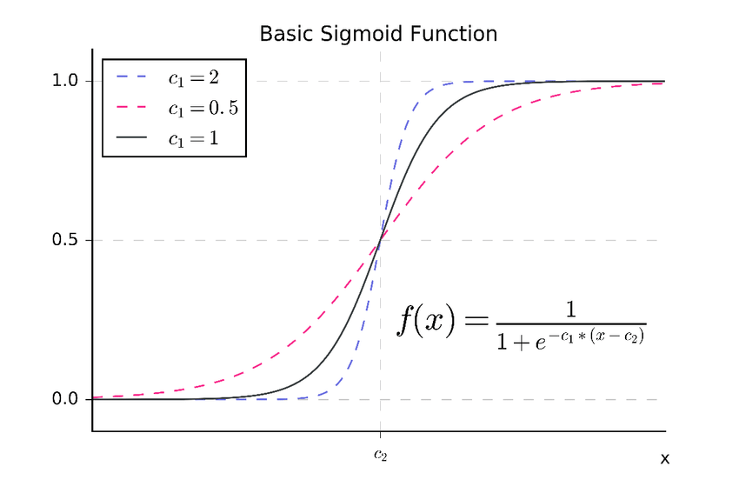
A Basic sigmoid function with two parameters (c1 and c2) (Revkin et al., 2008).

Slide 18
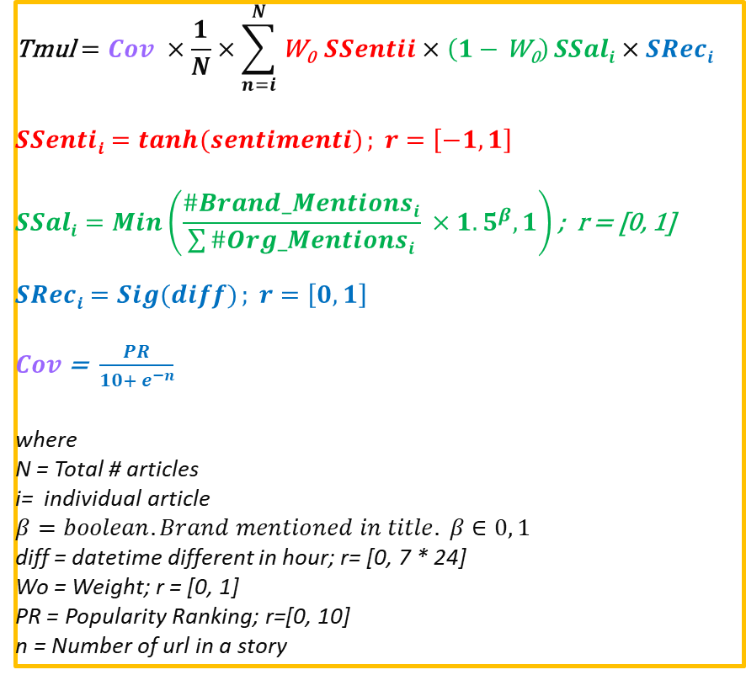
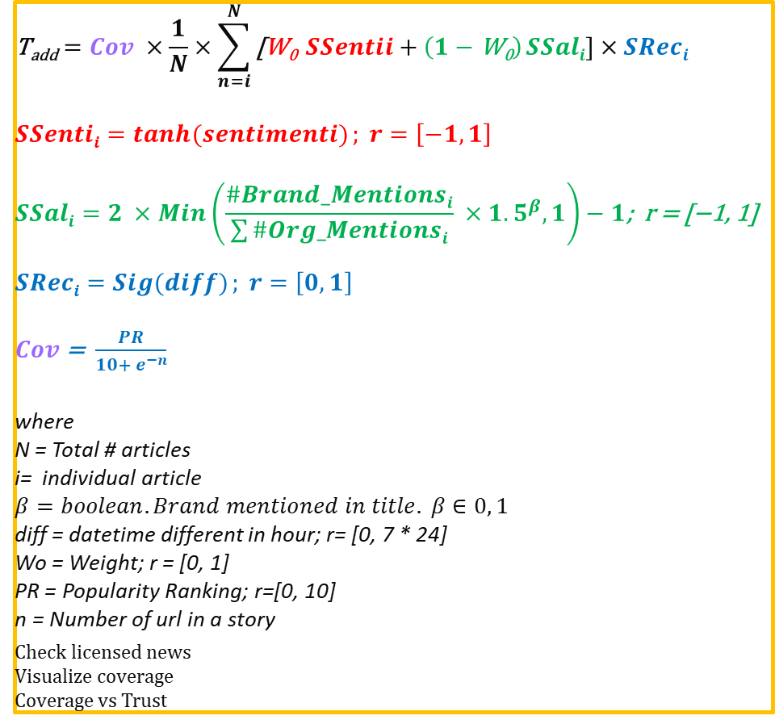
$$\text{T}\text{add}=Cov ×\frac{1}{N}×\sum_{n=i}^{N}{\text{[}\text{W}\text{0}} SSentii+\left(1−\text{W}\text{0}\right) SSali]×SReci$$
$SSentii=tanh⁡(sentimenti)$ $; r=\left[−1, 1\right]$
$$SSali=2 ×Min\left(\frac{\#Brand_Mentionsi}{\sum{\#Org_Mentionsi}} ×{1.5}^{β}, 1\right)−1\text{; }\text{r}\text{ = [−1, 1] }$$
$SReci=Sig(diff)$ $; r=\left[0, 1\right]$
$Cov$ = $\frac{PR}{10+ e^{−n}}$
where
N = Total # articles
i= individual article
$$β=boolean. Brand mentioned in title. β∈0, 1$$
diff = datetime different in hour; r= [0, 7 * 24]
Wo = Weight; r = [0, 1]
PR = Popularity Ranking; r=[0, 10]
n = Number of url in a story
_{Check licensed news}
_{Visualize coverage}
_{Coverage vs Trust}
$$\text{Tmul}=Cov ×\frac{1}{N}×\sum_{n=i}^{N}{\text{W}\text{0}} SSentii×\left(1−\text{W}\text{0}\right) SSali×SReci$$
$SSentii=tanh⁡(sentimenti)$ $; r=\left[−1, 1\right]$
$$SSali=Min\left(\frac{\#Brand_Mentionsi}{\sum{\#Org_Mentionsi}} ×{1.5}^{β}, 1\right)\text{; }\text{r}\text{ = [0, 1] }$$
$SReci=Sig(diff)$ $; r=\left[0, 1\right]$
$Cov$ = $\frac{PR}{10+ e^{−n}}$
where
N = Total # articles
i= individual article
$$β=boolean. Brand mentioned in title. β∈0, 1$$
diff = datetime different in hour; r= [0, 7 * 24]
Wo = Weight; r = [0, 1]
PR = Popularity Ranking; r=[0, 10]
n = Number of url in a story

Slide 19
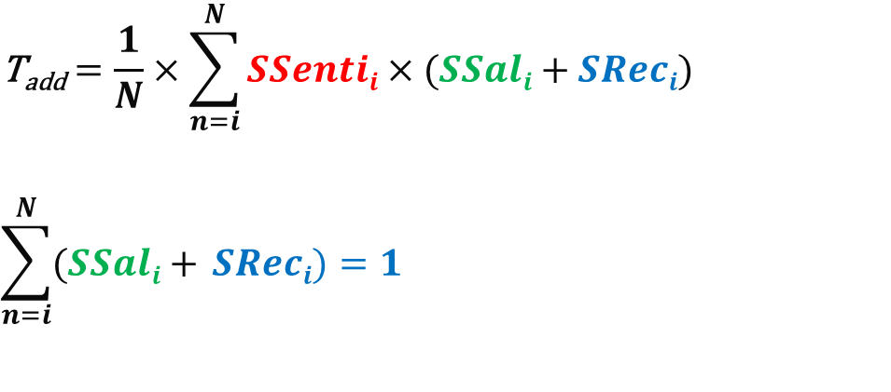
Weight that Sum up to 1 (all articles)
$$\text{T}\text{add}=\frac{1}{N}×\sum_{n=i}^{N}{SSentii×(SSali+SReci})$$
$$\sum_{n=i}^{N}{(SSali+ SReci})=1$$

